Slide 1
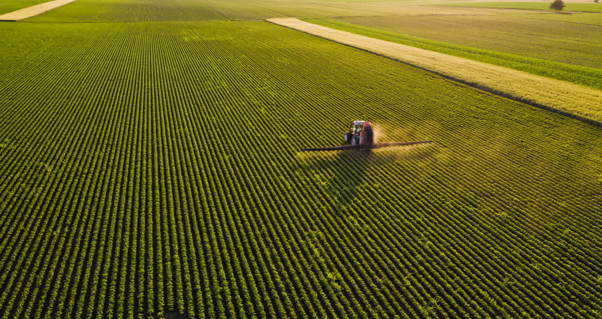

HempChain
The Smart Solution for Industrial Hemp Tracking

Slide 2

The Problem
2018 Farm Bill
Statewide Hemp Tracking
Interstate Hemp Tracking
Bill of Lading
Chain of Custody
Certificate of Analysis

Slide 3
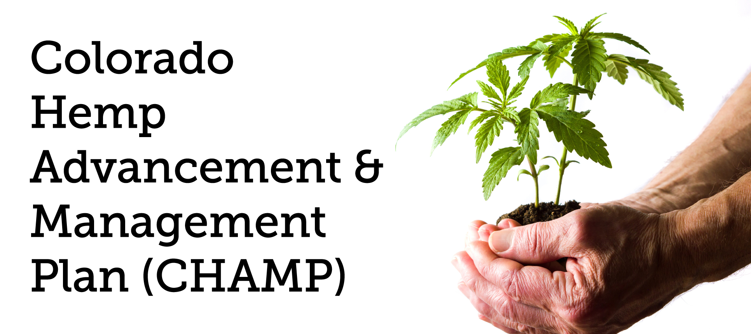
The Problem
Trust Issues
Hemp shipments stuck at Wyoming borders
Arrests
Seized Property
Colorado stipulated needs blockchain solution by harvest 2020(reword)

Slide 4

Solution
Solution: Life Cycle Tracking
Allows Farmers and Transporters peace of mind
Allows farmers, processors, manufacturers to know what they are buying
Allows Regulators to see what is going on inside shipments and their state

Slide 5
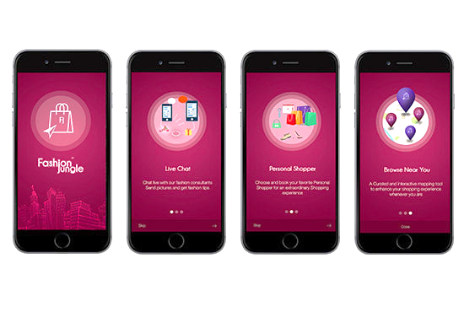
Features
Blockchain
QR Codes / Serial Numbers
Seed to shelf
Interface to interact with data
Information Held in Blockchain:
Chain of Custody – where/who?
Lab Results – legal/illegal?
Bill of Ladings – cross state lines

Slide 6
Qr codes
Show qr codes
Show how labs can be different levels of accreditation
Transparency of the tests
WE ARE NOT LIABLE~~~

Slide 7










Our Customers
Seed
Cultivation
Testing
Transportation
Processing
Regulation
Manufacturing
Insurance
Our best customer is Regulators, as we hope to provide an ecosystem for tracking throughout the entire USA

Slide 8
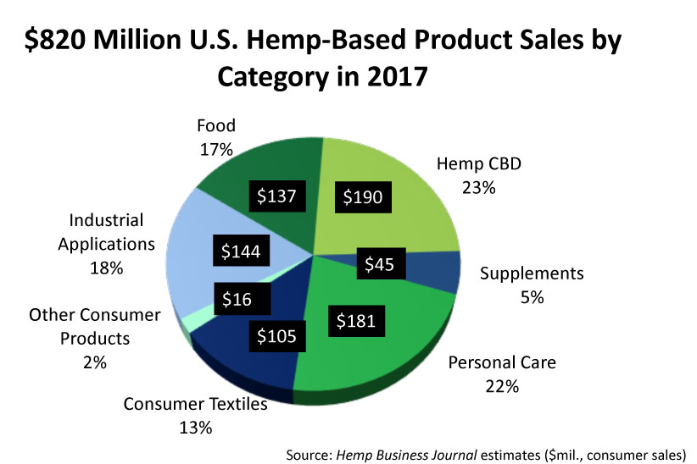
Segmentation Model
The 2019 US Hemp market: $2.1 Billion
$15 billion by 2026
12,343 active hemp cultivator licenses
544 active hemp seed licenses
1,323 active processor licenses.
Cultivation in Colorado in 2019 is expected to be more than double 2018
Hemp acreage in Kentucky will triple in 2019
Tennessee, there will be more than 12-times the acreage in 2019 compared to 2018

Slide 9


Competition
System already in place for Colorado marijuana tracking from seed to sale
All MED Licensed Medical and Retail Marijuana businesses are required to use metrc® as the primary inventory tracking system of record.
Focus on Marijuana
SeedA to Sale for Colorado
The most successfully-deployed regulatory cannabis system in the world
Cannabis software and business solutions for compliant marijuana seed-to-sale tracking and data reporting.
Current State licenses in East side of the country
Focus on Marijuana
Expensive Hardware Implementation
JarrowTech
Current interest in JarrowTech
Colorado wants a blockchain based tracking system for hemp, we are talking with their electronic solution team through the Champ Initiative
Wyoming has given us a letter of confidence in our idea for tracking hemp
Focus only on Industrial Hemp
Seed to Sale across borders
App based system for the entire supply chain

Slide 10

Marketing Strategy
For Cultivators, Processors, and Manufacturers:
Live Demonstration Events
Promotional Videos
Social Media Advertisements
Helping in the Hemp Farming Community
Touring Farms, Processors, and Manufacturers
Customer Acquisition:
Champ Initiative
Governor Polis has the final decision on what happens in Colorado with hemp
Working/Talking with digital solutions team
Prospective Customers:
State Agriculture Departments
Cultivators, Processors, and Manufacturers
Transportation Companies

Slide 11
Sales & Channel Strategy
Determine specific needs for state regulators
How we differ from the standard now
Show how the product would be used by a demonstration
Inform them about pricing plans that would best suit them
Consult and develop a beta per customer needs with the expanding industry
Business to Regulators and Law Enforcement:
Licensing based system for each individual department that wants access to the data
Business to Transportation, Cultivators, Processors, and Manufacturers:
2% Sales Fee on each transaction that occurs on the blockchain that involves payment

Slide 12
Revenue Model
As a company we are NOT trying to develop an individual channel but an entire ecosystem
We acknowledge this will be more difficult, but it is what the hemp industry is looking
for right now and will provide us with greater incentive
Our Three main channels are listed below:
Regulating Agencies
(Licensing Model)
Examples:
Police Officers
Departments of Agriculture
Departments of Revenue
Departments of Health
*yearly contract based on licensed users
Consumers
(2% Sales Fee)
Examples:
Transporters
Cultivators
Processors
Manufacturers
*Every monetary transaction has an associated 2% sales fee
Customization for Agencies
(Single Sale)
Examples:
Regulators
*Custom Solutions for Regulators including adding new features
Customization for Companies/Agencies

Slide 13
Cash Flow and Profit & Loss Statement

Slide 14





Thank You
James Schuchardt & Carlton Wilcox
contactcenter@jarrowtech.com
www.JarrowTech.com

Slide 15
Q&A

Slide 16
Will you Drop Out for the business?
Yes, we can.
Yes, we will.
Customization for Companies/Agencies

Slide 17
Are you going to keep this a Wyoming Business?
Yes we will.
Customization for Companies/Agencies

Slide 18
Potential Partners?
We aren’t looking at partners as of right now.
If we were, they would be development teams and blockchain organizations.
Customization for Companies/Agencies

Slide 19
Mobile App Team: A team of about 5 people to help with building/maintaining our different versions for customers. Database Dev Team: A team of about 8 people to help build smart contracts/maintain connections/develop APIs. Website Design Team: A team of about 4 people to develop a good website that looks great and has functionality with our databases. Security Testing: A team of about 2-4 people to constantly try and break every single part of our system in order to improve our security and be ahead of malicious actors.
What kind of employment would you provide?

Slide 20
What kind of employment would you provide?
Sales Team: A team of about 6 people to help with marketing, public relations, and contact potential clients. Government Relations Team: A team of about 4 people to maintain communications with government authorities and to aid in contract building/negotiation.
Customer Support: A team of about 4 people to start, this team will take in information from consumers and actors in order to provide information to the different teams.

Slide 21
If given 0-50,000?
1
2
3
4
5
6
7
8
9

Slide 22
If given 50,000-100,000?
1
2
3
4
5
6
7
8
9

Slide 23
If given 100,000-1,000,000?
1
2
3
4
5
6
7
8
9

